Slide 1
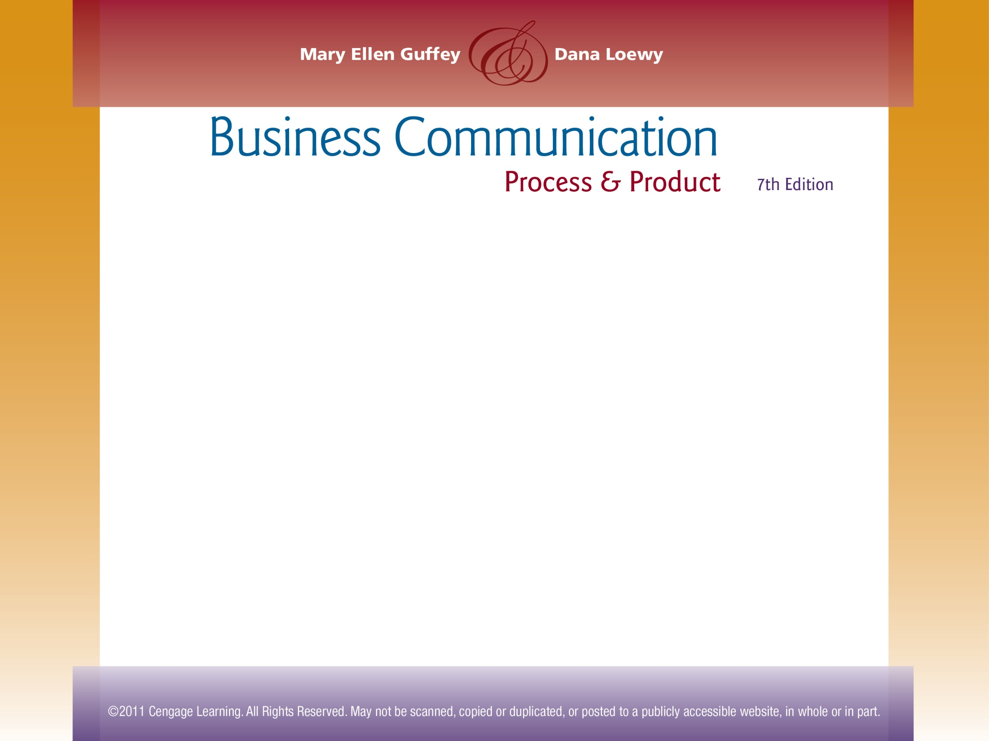

Chapter 4
Planning Business Messages

Slide 2
Topics in This Chapter
Defining Business Writing
Guffey’s 3-x-3 Writing Process
How to Analyze, Anticipate, and Adapt
Reader Benefits and the “You” View
The Team Writing Process
Legal and Ethical Responsibilities

Slide 3
What Business Writing Is
Purposeful - it conveys information and solves problems
Persuasive - its goal is to make the audience accept the message
Economical – it’s concise and doesn’t waste the reader’s time
Reader-Oriented - it focuses on the receiver, not the sender

Slide 4
Guffey’s 3-x-3 Writing Process
Prewriting
Analyze
Anticipate
Writing
Research
Compose
Revising
Edit
Proofread
Adapt
Organize
Evaluate
The steps may be rearranged, abbreviated, or repeated.

Slide 5
Scheduling the Writing Process

Slide 6
Components of the First Phase of the Writing Process
Analyzing the task includes
Identifying the purpose
Selecting the best channel
Anticipating the audience includes
Visualizing primary readers
Visualizing secondary readers

Slide 7

Three Major Audiences to Envision When Determining What to Write
Colleagues
Superiors and decision makers
Customers and general audiences
Notes:
8

Slide 8


Questions to Ask When Selecting the Best Channel for a Message
How important is the message?
How much feedback is required?
How fast is feedback needed?
Is a permanent record necessary?
E-Mail?
Instant Message?
Letter?
Notes:
8

Slide 9


Questions to Ask When Selecting the Best Channel for a Message
How much can be spent?
How formal is the message?
How sensitive or confidential is the message?
Memo?
Voice Mail?
Notes:
8

Slide 10
Media Richness Theory
Describes the extent to which a channel or medium recreates or represents all the information available in the original message
Specifies that a richer medium, such as face-to-face conversation, permits more interactivity and feedback

Slide 11
Media Richness Theory
Specifies that a leaner medium, such as a report or proposal, presents a flat, one-dimensional message
Specifies that richer media enable the sender to provide more verbal and visual cues and allow the sender to tailor the message

Slide 12
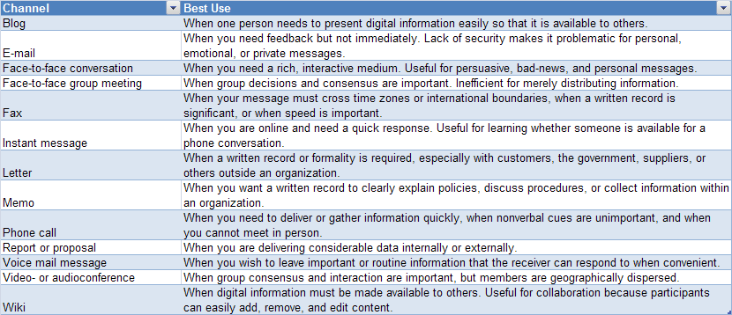
Media Richness Theory
Choosing Communication Channels

Slide 13
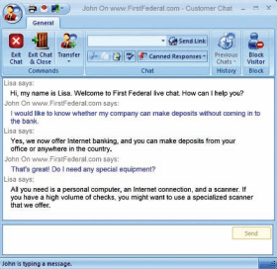
The Internet Has Increased the Need for Solid Writing Skills
Many businesses now help customers with live chat, which requires customer representatives to be able to write clear, concise, conversational, and correct responses.

Slide 14
Eight Adaptive Techniques to Create a Positive Tone in a Message
1
Spotlight audience benefits.
For example, the warranty starts working for you immediately
Cultivate the “you” view.
For example, your account is now open
2
Notes:
8

Slide 15
Eight Adaptive Techniques to Create a Positive Tone in a Message
3
Be conversational but professional.
For example, your report was well written, not your report was totally awesome
Express thoughts positively.
For example, you will be happy to, not you won’t be sorry that
4
Notes:
8

Slide 16
Eight Adaptive Techniques to Create a Positive Tone in a Message
5
Be courteous.
For example, please complete the report, not you must complete the report!
Strive for bias-free language, avoiding gender, race, age, and disability biases.
For example, office workers, not office girls
6
Notes:
8

Slide 17
Eight Adaptive Techniques to Create a Positive Tone in a Message
7
Use plain language and familiar words.
For example, salary not remuneration
Employ precise, vigorous words.
For example, fax me, not contact me
8
Notes:
8

Slide 18
Developing Reader Benefits and the “You” View
Sender-Focused
We are requiring all staffers to complete these forms in compliance with company policy.
Because we need more space for our new inventory, we are having a two-for-one sale.
Receiver-Focused
Please complete these forms so that you will be eligible for health and dental benefits.
This two-for-one sale enables you to buy a year’s supply of paper, but pay only for six months’ worth.

Slide 19
Developing Reader Benefits and the “You” View
“I” and “We” View
We take pleasure in announcing an agreement we made with HP to allow us to offer discounted printers in the student store.
“You” View
An agreement with HP allows you and other students to buy discounted printers at your student store.

Slide 20
Developing Reader Benefits and the “You” View
“I” and “We” View
We are issuing a refund.
I have a few questions on which I would like feedback.
“You” View
You will receive a refund.
Because your feedback is important, please answer a few questions.

Slide 21
Negative Expressions and Their Hidden Messages
Negative Expression
You overlooked
You state that
You failed to
You claim that
You are wrong
Hidden Message
You are careless.
I don’t believe you.
You are careless.
It is probably untrue.
I am right.
Writers are sometimes unaware of the hidden messages they send with their words.

Slide 22
Negative Expressions and Their Hidden Messages
Negative Expression
You do not understand.
Your delay
You forgot to
Hidden Message
You are not very bright.
You are at fault.
Besides being inefficient, you are stupid and careless.
Writers are sometimes unaware of the hidden messages they send with their words.

Slide 23
Team Writing Is Often Necessary for Project Work
When projects are larger than one person can handle
When projects have short deadlines
When projects require the expertise or consensus of many people

Slide 24
Three Phases for the Team Writing Process
Phase 3 Revising Team members work together to synthesize, but one person may do the final proofreading.
Phase 1 Prewriting Team members work closely to determine purpose, audience, content, and organization.
Phase 2 Writing Team members work separately.

Slide 25


Adapting to Legal and Ethical Responsibilities
When communicating investment information, avoid misleading information, exaggeration, and half truths.
When communicating safety information, warn consumers of risks in clear, simple language.

Slide 26

Adapting to Legal and Ethical Responsibilities
When communicating marketing information, avoid statements that falsely advertise prices, performance capability, quality, or other product characteristics.

Slide 27

Adapting to Legal and Ethical Responsibilities
When communicating human resources information
Avoid subjective statements in evaluating employees; describe job-related specifics objectively.
Avoid promissory statements in writing job ads, application forms, and offer letters.

Slide 28
Adapting to Legal and Ethical Responsibilities
Assume that everything is copyrighted.
Understand that Internet items are NOT in the public domain.
Observe fair use restrictions.
©

Slide 29
Four-Factor Test to Assess Fair Use
Purpose and character of the use
Is the item to be used for profit or nonprofit?
Is the information necessary for the public good?
Amount and substantiality of portion used
Is the amount to be copied a small portion of a large work or a substantial portion of a small work?
Effect on the potential market for or value of the copyrighted work
Does the fair-use copying interfere with the author’s potential profit from the original?
Nature of copyrighted work
©
$

Slide 30


How to Ensure Fair Use
Question
How can you always be safe?
Answer
By John S. Donnellan
Ask for permission to borrow!

Slide 31
End

